Slide 1
Testing pMEMS Devices
Joe Evans, Sean Smith PhD, Naomi Montross,
Scott Chapman, Michael McDaniel,
Radiant Technologies, Inc.
Session 10B 15:00—15:15 March 30, 2023
15th International Meeting on Ferroelectricity
Tel Aviv, Israel March 26-30
Notes:
1

Slide 2
Outline
Problem Statement
Introduction
  Presenter
  Tester
  Accessories
  Software
Know your test environment
Measure your pMEMS characteristics
Publish (academic)…or produce (industry)
Notes:
Inspiried by IC testing. Scaled down for R&D scale piezoMEMS. Designed for Analogue systems
DIP: Dual Inline Package
2

Slide 3
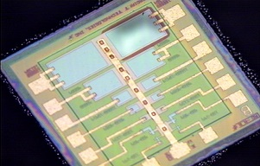
Problem Statement
Congratulations! You’ve now produced a physical sample to provide empirical data to prove your theoretical concept. However, pMEMS devices may be more complex to evaluate than standard piezoelectric or ferroelectric capacitors.
Introducing…the “Device Under Test” or DUT
Radiant Technologies AFM Reference Membrane
A version of these are provided as reference devices in all our testers

Slide 4
Introductions
Michael McDaniel: BSEE/MSEE. 36 years experience. Industries ranging from telecommunications, earthmoving equipment, mining automation, motor controls, avionics, and now materials. Roles include product development, advanced research, production and manufacturing support, project and product management.
Joined Radiant December 2021 to develop products and accessories to enable customer testing

Slide 5
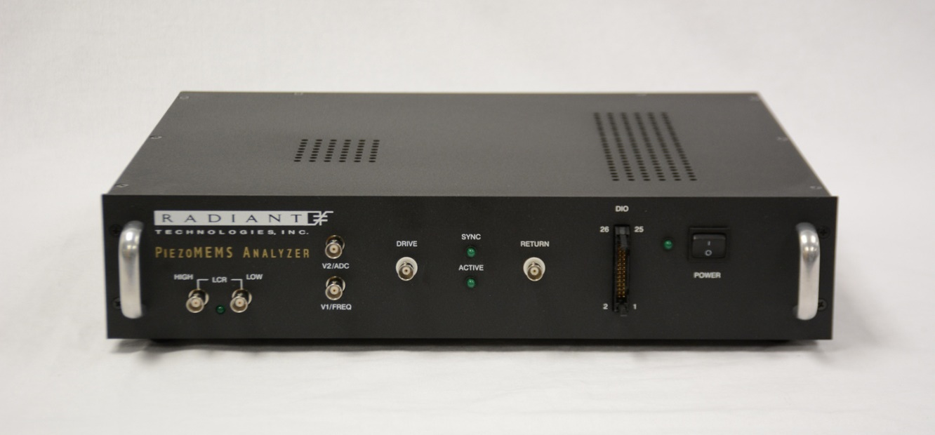
Radiant pMEMS Analyzer
Additional Stimulus/Measurement Ports
Digital I/O Port
Product Details are on our website: www.ferrodevices.com

Slide 6
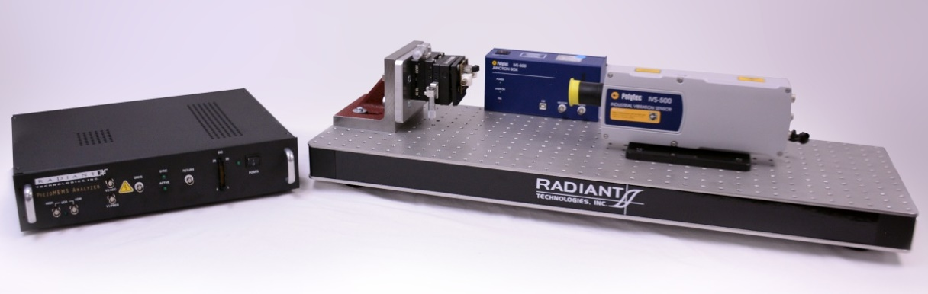
Introductions…Radiant Nanometer Measurement Platform
Based on Polytec IVS-500 Laser Doppler Vibrometer (LDV)
Configured to test mounted pMEMS samples
68 pm resolution
~70 μm spot size

Slide 7
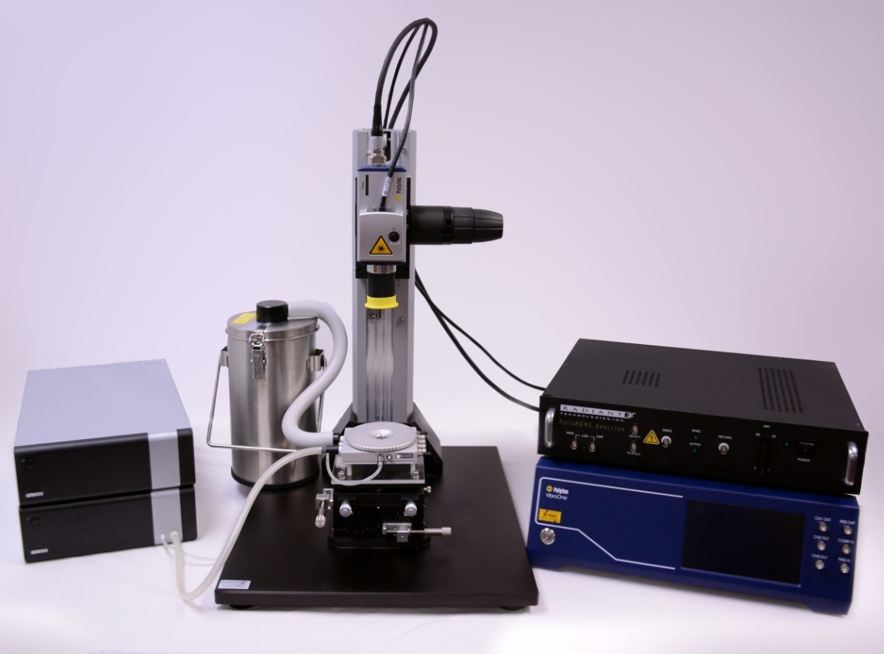
Introductions…Radiant High-Resolution
Angstrom Level Measurement Platform
Based on Polytec
VibroOne LDV
Shown with available
Linkam HFS-600E
temperature stage.
Also available with
Probe Station or
tip-tilt platform
2 μm spot size
0.3 pm resolution
Integrated camera
Mounted pMEMS
Wafers
Die

Slide 8
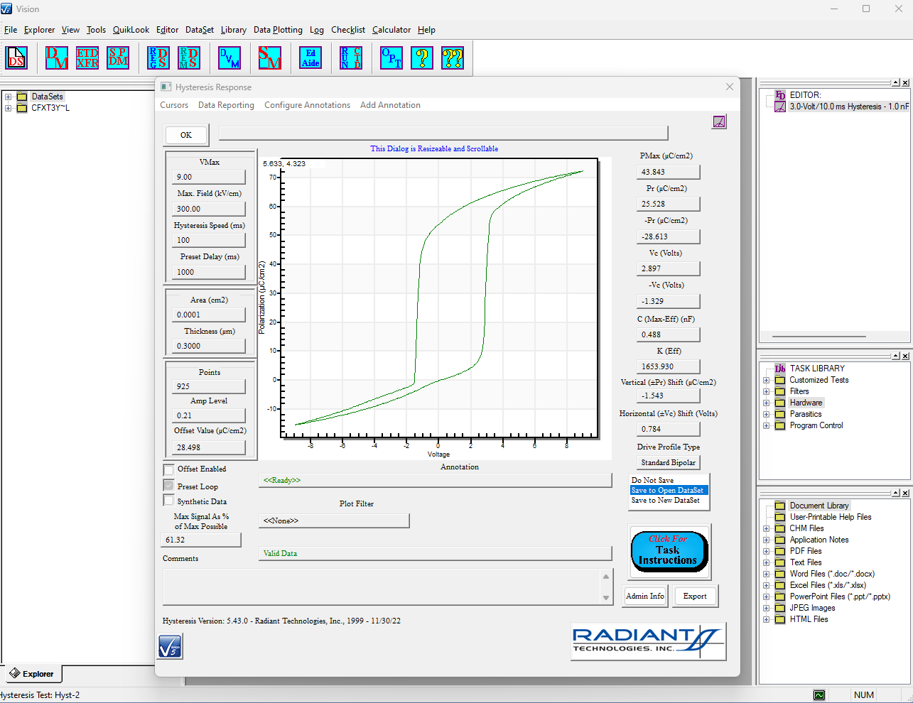
Vision Data Acquisition
Not only data acquisition. Test Setup, post-processing, data storage
Your electronic “Laboratory Notebook!”

Slide 9
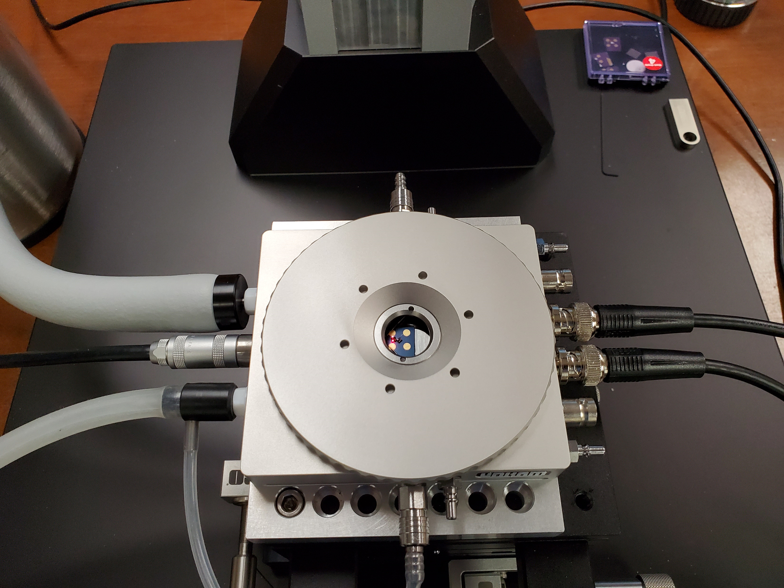
Know your Environment…
Linkam HFS-600E

Slide 10
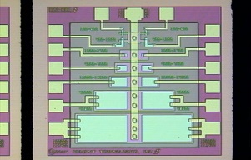
Effect of the Window in Linkam HFS-600E
The Linkam stage has a window to allow laser displacement measurements. How does refraction affect the measurement?
Test full operation first with the lid to the chamber removed.
Test again with the lid in place.
Red = without window
Blue = with window
7 Angstrom loop!
Surface piston of a clamped 0.25 µm-thick 20/80 PZT solid-state capacitor at room temperature.
RT
Note: Cantilevers bend, and refraction *may* be a concern when measuring them!

Slide 11
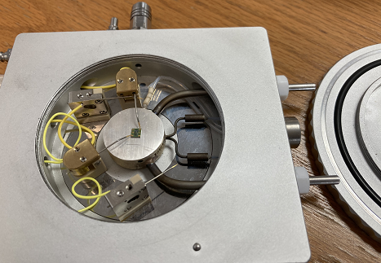
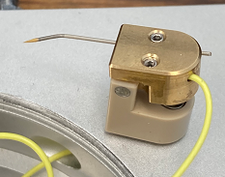
New Linkam Probes!
New vs old micropositioners in HFS-600 chamber. In the image below the probes are landed on pads 400 μm x 700μm.
Collaborative effort between Linkam and Radiant

Slide 12
Know your Environment…
Polytec LDV Noise
NLV (Predecessor to VibroOne)
Single-pass resolution of LDV is 0.3Å, highlighted in Red
Notes: The interval is much faster than the mechanical noise, so the LDV is putting out an analog voltage corresponding to “zero” in this entire interval. The tester sensor resolution is much finer than the quantization of the LDV and is capturing electrical noise around the actual LDV output

Slide 13
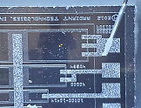
pMEMS Characterization
Using x16 averaging at a frequency ~5 kHz to minimize ambient mechanical noise, the VibroOne can measure the 6.5 Ångstrom butterfly loop of a 0.25 µm-thick 4%-doped 20/80 PZT.
The test profile consists of two continuous cycles so two traces appear in each parameter. All three parameters were captured synchronously.
10µm features
90°C
*Die image taken with coaxially-aligned camera embedded inside the VibroOne.

Slide 14
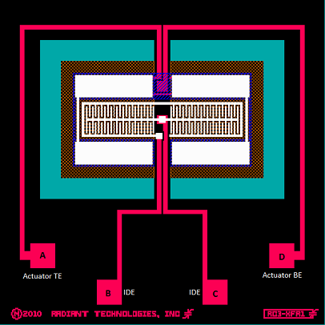
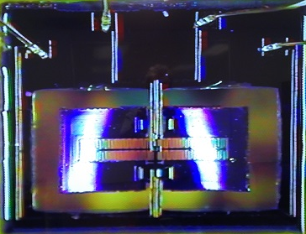
pMEMS Characterization
Through-wafer hole
Cantilever “Wing”
The wings are ~5μm thick. The central crossbar holding the two wings is full-wafer thickness. Parallel-Plate capacitors surround the cantilever edges while Interdigitated Electrode (IDE) capacitors form the center spine.
How does this design perform with the two different capacitors driving the cantilever?

Slide 15
Cantilever – Parallel Plate Excitation
Parallel-Plate Actuator
Gap in butterfly loop matches gap in polarization loop.
Cantilever tip double butterfly loop driven by parallel-plate capacitors at 20V/1Hz with 32,000 points.

Slide 16
Cantilever – Interdigitated Excitation
Cantilever tip double butterfly loop driven by IDE capacitors at 165V/1Hz with 32,000 points.
Since both capacitors use THE SAME MATERIAL, we can characterize the two devices without introducing variation due to deposition differences!

Slide 17
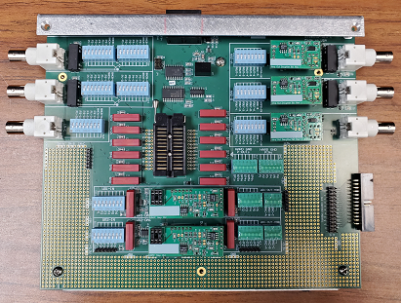
Matrix
Connections between the tester and DUT can be switched by Vision and become part of the test record
The Output and Feedback amplifiers are customizable plug-in modules that can be swapped on-site to change their function for different test conditions or different DUTs.
Used internally for testing at Radiant
(Enclosure removed to show PCB details)

Slide 18
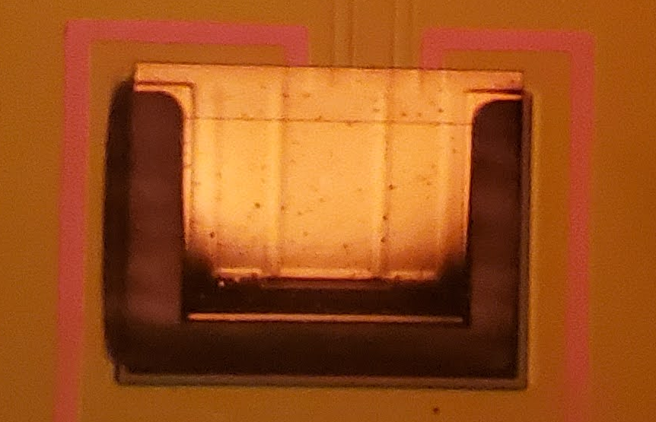
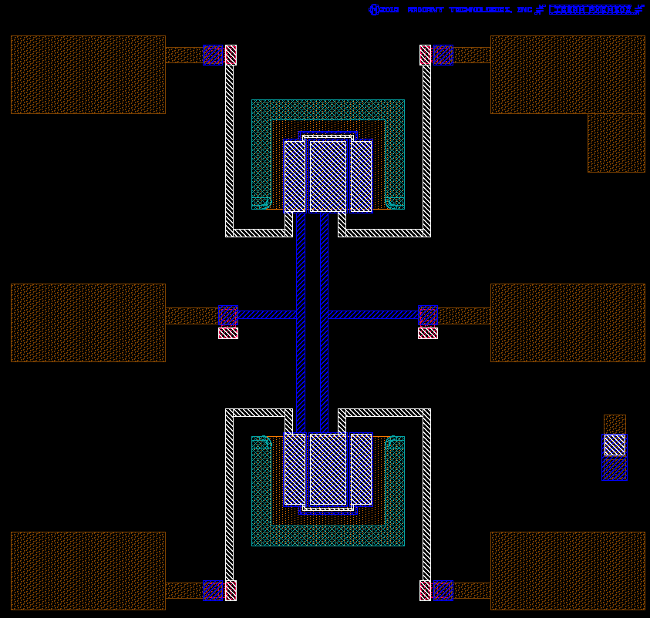
pMEMS Characterization: Resonance
Drive (V)
Disp.(µm)
Time (ms)
Disp.(µm)
FFT Amp.
Time (ms)
Frequency (Hz)

Slide 19
Acknowledgements
  The authors would like to thank
  Polytec GmbH (https://www.polytec.com/us/)
  Linkam Scientific Instruments (https://www.linkam.co.uk/)
  for their assistance in this evaluation.

Slide 20
Publish or Produce your Results
A Radiant piezoMEMS Analyzer coupled with a
Polytec laser vibrometer will measure not just
your piezoMEMS device, but also the
environment of your test.
Reduce electrical and mechanical noise sources
Run your cleanest practical test possible
Averaging can improve results
All of this can be done within Vision and the Advanced Piezoelectric tasks…no exporting data required.

Slide 21
Extra Slides

Slide 22
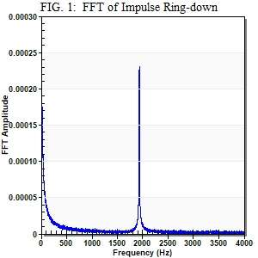
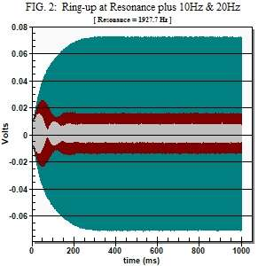
Abstract:
To determine the performance envelope of thin film piezoMEMS devices or verify their operation, electrical and mechanical components must be characterized individually
then their combined electromechanical functionality tested. For this purpose, the authors have constructed a unique test system with supporting instrumentation, sensors,
and software that allows automated testing of complex piezoMEMS over temperature (-195°C to 600°C). The system combines a laser doppler vibrometer
(0.3 Ångstrom resolution) with an intelligent multiplexer circuit card to analyze the Device Under Test in a small temperature chamber or on a probe station.
Integrated software captures the electrical response and mechanical motion from multiple devices on a single die while controlling temperature (if the optional temperature
chamber is used). The authors will describe standardized tests that identify fundamental parameters of a piezoMEMS. The electrical properties of the capacitors are first
evaluated for yield and uniformity. Those capacitors are then electrically poled to allow actuation of mechanical members to measure large signal, low frequency
electromechanical displacements. The impulse response induces ring-down which reveals resonant frequencies of the mechanical members (Figure 1). Ring-up driven by
a small continuous sinusoid (Figure 2) can establish the quality factor and displacement amplitudes at resonance.

