Slide 1
Dual e₃₁: Direct and Converse e₃₁ Measurement for a Single Thin Film Sample
Sean W. Smith, Bernardo Martinez-Tovar, Michael S. McDaniel, Naomi B. Montross, Eduardo Villareal, and Joe T. Evans
Radiant Technologies, Inc.
2024 IEEE UFFC JS
2024 09 24
Booth 41

Slide 2
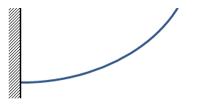
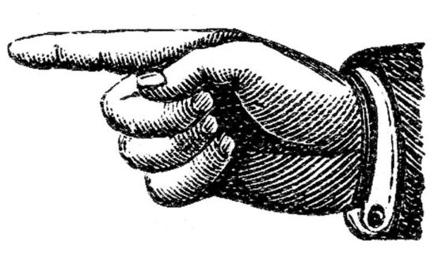
Issue
Converse
Stimulus
  The effective transverse piezoelectric coefficient (e₃₁) is useful for piezoMEMS design.
  Measuring e₃₁ from the converse piezoelectric effect is straightforward.
  Measuring e₃₁ from the direct piezoelectric effect has been more difficult.
  Radiant proposes our Dual e₃₁ technique to measure both the converse and direct e₃₁ simultaneously from a single sample
Tester
DRIVE
RETURN
Uniform strain response
Direct
Response
Tester
DRIVE
RETURN
Stimulus: strain
may be nonuniform
Notes:
Capacitor generates uniform strain along the cantilever
Mechanical deformation doesn’t necessarily create a uniform strain. Modeling this can be challenging.
May require a different sample than for the converse measurement

Slide 3
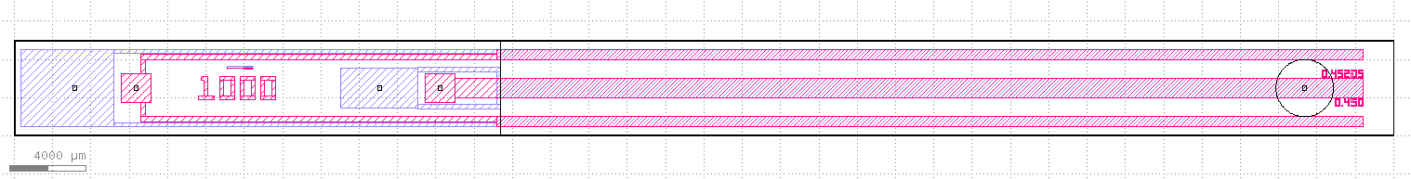
Two Capacitor Cantilever
Clamped
Measure Point
Top Electrode → Red Bottom Electrode → Blue
  75 mm long, 5 mm wide
  One capacitor to actuate → Converse e₃₁
  One capacitor to sense → Direct e₃₁
  Capacitor design:
    Mechanically coupled – single cantilever
    Electrically isolated – separate bottom and top electrodes
    Extend past measure point – uniform strain – cantilever forms arc
    Equal length and area – either capacitor can sense/actuate
    Capacitor thickness 1 µm << cantilever thickness 525 µm – use silicon mechanical properties
    Symmetric about long axis – minimizes twisting
Notes:
This is the layout of our two capacitor Dual e31 cantilever

Slide 4
Dual e₃₁ Measurement
  Apply voltage to the actuator capacitor to bend the cantilever.
  Measure the displacement.
    Converse e₃₁ and surface strain
  Capture the charge generated by the sense capacitor.
    Sense polarization
  Calculate the Direct e₃₁ coefficient by dividing the surface strain into the sense polarization.
z
x
t_{Cap}
t_{Si}

Slide 5
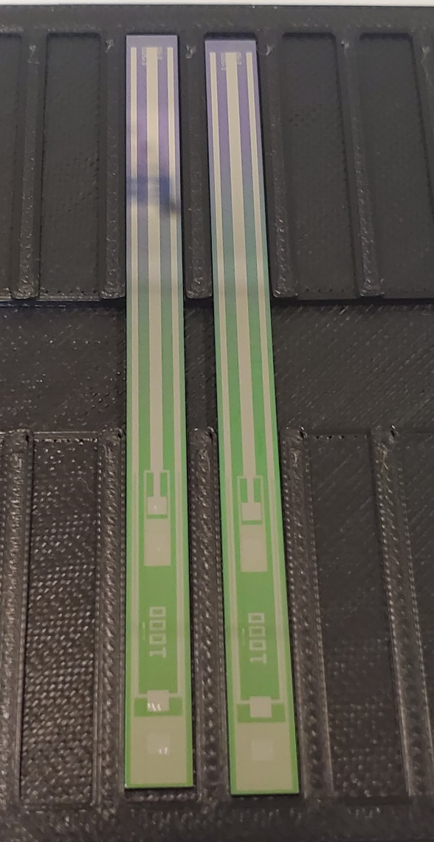
PZT Thin Film Dual e₃₁ Cantilevers
  Silicon substrate (100) 525 µm thick with 500 nm thermal SiO₂ and 40 nm TiO₂
  Pt bottom electrode 150 nm lift-off
  ~1 µm PZT by sol-gel
    20/80 4% Nb
    30/70
    40/60
    52/48
    65/35 9%La
  Pt top electrode 100 nm lift-off
Cool Cantilever photo
Dual e₃₁ Cantilever

Slide 6
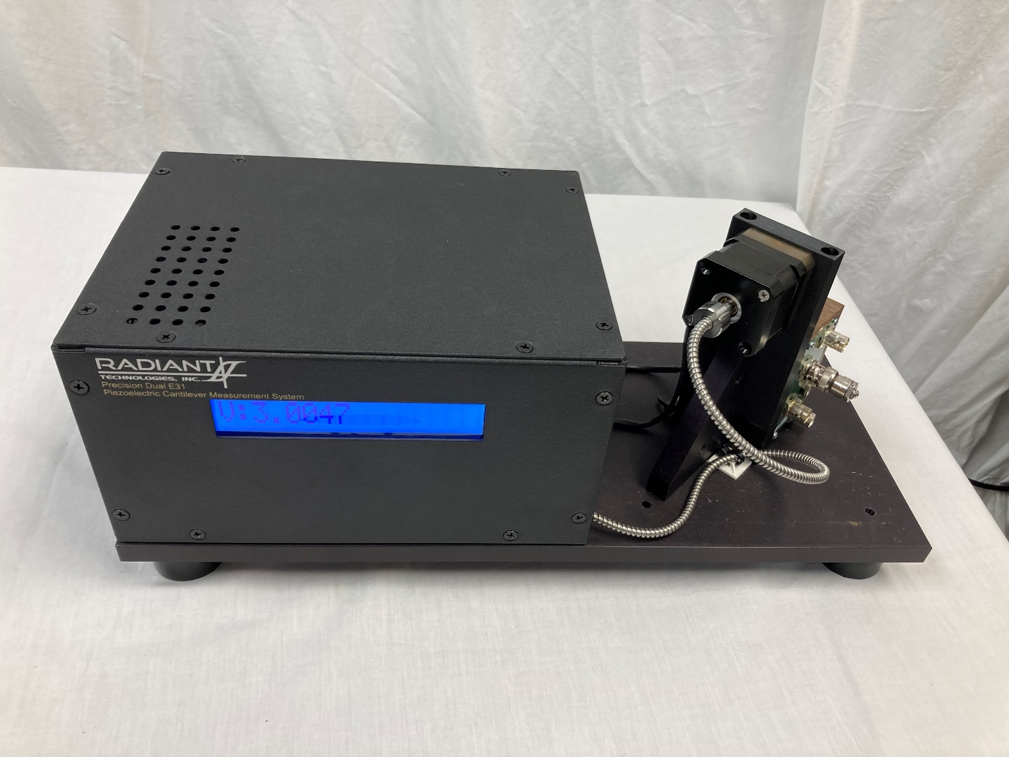
Test Fixture
  Built off our converse e₃₁ measurement system
  Photonic displacement sensor self-calibrates
  Five BNC connections
    Four pogo pins on cantilever frontside
    Fifth for cantilever backside to ground substrate
    Vision controlled connection swapping in final design (Multiplexer)
  Lid (not shown) reduces thermal and electrical noise
Prototype dual e₃₁

Slide 7
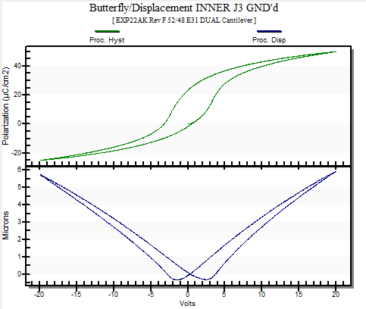
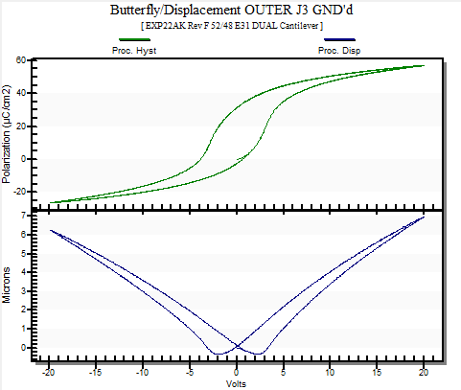
Measure Each Capacitor
Tester
DRIVE
  Drive inner capacitor
  Measure displacement
  Measure inner capacitor polarization
RETURN
  Drive outer capacitor
  Measure displacement
  Measure outer capacitor polarization
Tester
DRIVE
RETURN

Slide 8
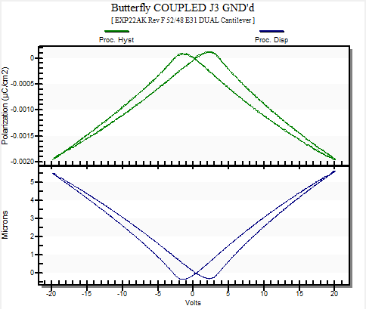
Measure Dual e₃₁
  Drive outer capacitor
  Measure displacement
  Measure inner capacitor polarization
  Slow, 0.5 Hz (2s) or less
  Ground opposing electrodes
Tester
  Converse e₃₁
  -14.4 C/m²
  Direct e₃₁
  -11.9 C/m²
  Shapes match
RETURN
GROUND
DRIVE
GROUND
Notes:
NOTE: The Direct e₃₁ response is inverted to the displacement loop!

Slide 9
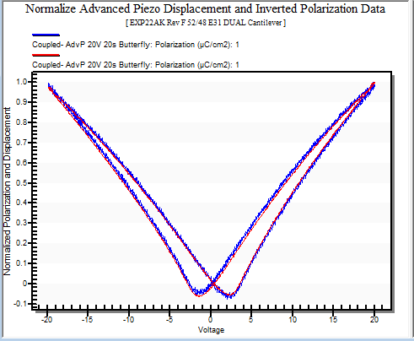
Normalize and Overlay Results
  Invert sense polarization and plot over displacement
  Sense polarization is linearly proportional to the surface strain, which is linearly proportional to stress, which is linearly proportional to the displacement
  Quantify by plotting sense polarization versus displacement.
Normalized Direct e₃₁ Charge
Normalized Displacement Loop
Sense Polarization:
Displacement:

Slide 10
Plot P_{Sense} vs Displacement z
  Good linear fit
  R², coefficient of determination, lets us quantify fit.
  Suggests sense polarization due to displacement
  Poor fit could indicate other factors generating charge
    Mechanical vibration
    Thermal variation
    Leakage between capacitors
Sense Polarization (µC/cm²) versus Displacement (µm) for a 52/48 PZT coupled e₃₁ measurement.

Slide 11
Results vs Composition
PZT | e₃₁ (C/m²) |  | R² Fit
 | Converse | Direct
4%Nb 20/80 | -12.3 | -7.7 | 0.9992
30/70 | -13.4 | -10.5 | 0.9989
40/60 | -9.8 | -9.5 | 0.9995
52/48 | -14.4 | -11.9 | 0.9975
65/35 | -9.8 | -3.8 | 0.9970
9%La 65/35 | -8.2 | -1.4 | 0.8829
  Direct e₃₁ < Converse e₃₁
  Most compositions have a good fit
  53/47 e₃₁ in literature [1]
    Converse -15.0 C/m² (at 10 V/µm)
    Direct -6.4 C/m²
[1] Yuichi Tsujiura, et al., Jpn. J. Appl. Phys., 54, 10NA04 (2015).

Slide 12
Results vs Composition
PZT | e₃₁ (C/m²) |  | R² Fit
 | Converse | Direct
4%Nb 20/80 | -12.3 | -7.7 | 0.9992
30/70 | -13.4 | -10.5 | 0.9989
40/60 | -9.8 | -9.5 | 0.9995
52/48 | -14.4 | -11.9 | 0.9975
65/35 | -9.8 | -3.8 | 0.9970
9%La 65/35 | -8.2 | -1.4 | 0.8829
  Converse follows displacement trend
  Direct follows sense polarization trend
  Fit poor for very small sense polarization

Slide 13
Summary
  Dual e₃₁ measurement simultaneously provides converse and direct e₃₁ coefficient from a single sample.
  Cantilever design simplifies applied strain measurement.
  Linear relationship between displacement and sense polarization as expected.
  The Dual e₃₁ fixture will be available fall 2024.
  Come visit us at booth 41 for a demonstration.
Sense Polarization (µC/cm²) and Displacement (µm) vs. Applied Bias for a 52/48 PZT coupled e₃₁ measurement.
Notes:
Dual e₃₁ measurement simultaneously provides converse and direct e₃₁ coefficient from a single sample. And we demonstrated this for a variety of compositions of PZT
Cantilever design simplifies applied strain measurement. Having two electrically independent capacitors is key
Linear relationship between displacement and sense polarization as expected. Deviations from this could be a sign of noise or other outside effects on the measurement.

Slide 14
Extra slides

Slide 15
Test Procedure
  Characterize and orient the actuator capacitor.
  Characterize and orient the sense capacitor.
  Drive the actuator capacitor against ground while capturing the cantilever displacement and simultaneously measuring the charge generated by the sense capacitor referenced to ground.
  Invert the sense capacitor loop then overlay the displacement and charge loops after normalizing them to unity.
    Do they overlay? If yes, the measurement is valid.
  Calculate the Converse and Direct e₃₁ coefficients.

Slide 16
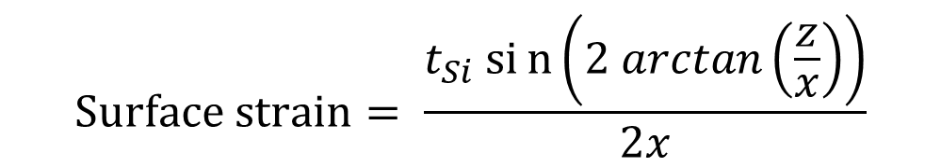
Assumptions and Constraints
  Capacitors extend past measure point
    Constant surface strain → cantilever forms an arc (circle segment)
  Capacitor thickness (t_{Cap}) << Cantilever thickness (t_{Si})
    1 µm << 525 µm
    Use silicon mechanical properties
  Then with cantilever length (x), vertical displacement (z) and cantilever thickness (t_{Si}) we can calculate the surface strain
z
x
t_{Cap}
t_{Si}
$$Surface strain= \frac{t_{Si} sin\left(2 arctan\left(\frac{z}{x}\right)\right)}{2x}$$

Slide 17

Dual e₃₁ Measurement
  Apply voltage to the actuator capacitor to bend the cantilever while measuring the displacement.
    Converse e₃₁ and surface strain
  Simultaneously capture the charge generated by the sense capacitor as it is bent by the actuator capacitor.
    Sense polarization
  Calculate the Direct e₃₁ coefficient by dividing the surface strain into the sense polarization.
$$ℯ_{31}=−\frac{E_{Si}{\left(t_{Si}\right)}^{2}}{3\left(1−ν\right)c_{f}x_{}^{2}}\frac{z\left(x\right)}{V}$$

Slide 18

4x4 Mux
  The fixture has a built-in 4x4 multiplexer to allow Vision to connect its DRIVE, RETURN, SENSOR, or GND channels to any one of the four pogo pins contacting the cantilever capacitor pads during execution of a test.
Dual E31 Fixture
Tester
RETURN
DRIVE
SENSOR
Pogo 4
4 x 4 Mux
Pogo 3
Pogo 2
Pogo 1

Slide 19
Measure Outer Capacitor
  Drive outer capacitor
  Measure displacement
  Measure outer capacitor polarization
  Slow, 0.5 Hz (2s) or less
Tester
DRIVE
RETURN

Slide 20
Measure Inner Capacitor
  Drive inner capacitor
  Measure displacement
  Measure inner capacitor polarization
  Slow, 0.5 Hz (2s) or less
Tester
DRIVE
RETURN

Slide 21
Evaluate Results
  The exact overlay of the shapes of the two loops indicates that there is a single negative coefficient that can multiply one to get the other:
  Peak displacement: 5.5 µm.
  Peak Polarization: -0.002 µC/cm²
  Direct e₃₁ Coefficient: -12.9 C/m²
Normalized Direct e₃₁ Charge
Normalized Displacement Loop
Charge:
Displacement:

